Slide 1
Economy and Revenue Forecast
"What's in Store for the FY 2016 DC Budget?"
Presentation to the DC Fiscal Policy Institute
March 19,2015
Steven Giachetti: Director of Revenue Estimation
Office of the Chief Financial Officer

Slide 2
Introduction
---
Overview
Current State of the District’s Economy
Labor Markets & Employment
Personal Income
The District’s resident employment in December 2014 was 14,566 (4.3%) more than the same period last year, measured by the 3-month moving average
The unemployment rate was 7.3% in December 2014, down from the high of 10.4% in 2011
December 2014 wage and salary employment in the District was up by 13,433 (1.8%) from one year earlier, measured by the 3-month moving average
The District’s per capita personal income was 168.3% of the U.S. average in 2013
In the quarter ended September 2014, the District‘s personal income grew by 4.2% and estimated wages of District residents grew by 4.1%, as compared to same period one year earlier
Most of the wage increase was due to growth in the private sector, but federal government wages also increased for the first time in 2 ½ years.
District Employment and Unemployment
District Per Capita Personal Income
($ in billions)
Source: U.S. Department of Labor, Bureau of Labor Statistics, U.S. Department of Commerce, U.S. Census Bureau, Bureau of Economic Analysis

Slide 3
Jobs in DC: Year-over-year change (December 2014)
3

Slide 4
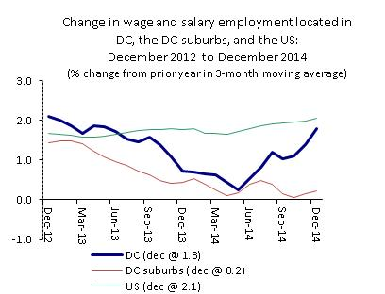
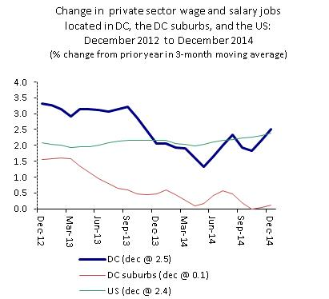
Jobs in DC, DC suburbs, US: 2-year Trend
4

Slide 5
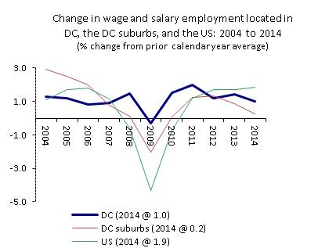
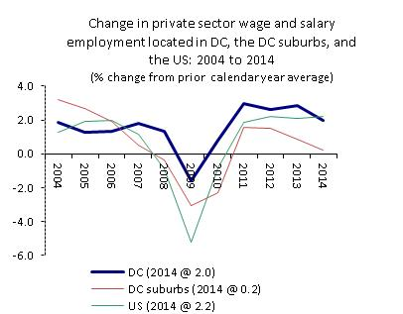
Jobs in DC, DC suburbs, US: 10-year Trend
5

Slide 6
Introduction
---
Overview
Current State of the District’s Economy (Continued)
Housing / Commercial Office Market
A Diverse Economic Region
The number of single family home sales in CY 2014 decreased by 0.9% and the average sales price increased 5.6%, as compared to CY 2013
Direct vacancy rate of commercial office space was 9.7% at year-end 2014, up from 9.6% in 2013
One of the most popular tourist destinations, with 350 historic sites and major cultural attractions
Washington Metro represents the 2nd busiest rapid transit system in the nation, behind New York City Subway
Home to many institutions, including over 9 colleges and universities, more than 50 museums, 206 foreign embassies, and a number of international organizations
The Housing Market Is Strong and Growing
The District’s Population Has Been Growing
D.C.’s population has grown by 53,904 since 2010
Source: February 2014 Revenue Estimates Certification Letter, U.S. Census Bureau

Slide 7
Outlook and Risks
National economy. Generally favorable national economic environment—GDP growth has picked up, and Blue Chip and other forecasts are for stronger growth in FY 2015 and FY 2016.
Federal government. Most likely will continue to be a stabilizing influence for DC; slower decline in spending will lessen the negative impact of this sector on DC’s economy.
Private sector diversification. With the federal government moving to the sidelines, the private sector is expected to drive job and wage growth in an increasingly competitive national economy.
Population. Population has grown 9 years in a row, adding 91,757 (16.2%) over that time. Population growth is set to continue to boost the tax base. The extent of future population growth depends on job opportunities, the quality of public services, and affordability of housing.
Stock market. The recent gains in the stock market, which has risen rapidly over the past year, underscores the importance of national and international capital markets to DC’s tax base.
Office market. The strength of this sector’s contribution to DC’s tax base growth depends on its ability to obtain tenants, remain profitable, and attract international investors.
7

Slide 8
February 2015 Revenue Estimate

Slide 9
Revenue Estimates for FY 2015-FY 2016 ,
Taxes 000s
 | Preliminary | Estimate
Revenue Source | FY 15 | FY 16
Total Property (net) | 2,242,095 | 2,363,301
year-over-year % chg | 8.1% | 5.4%
Total Sales (net) | 1,110,136 | 1,157,966
year-over-year % chg | 6.2% | 4.3%
Total Income | 2,172,268 | 2,267,384
year-over-year % chg | 3.7% | 4.4%
Total Gross Receipts (net) | 250,440 | 256,344
year-over-year % chg | 0.2% | 2.4%
Total Other Taxes (net) | 381,639 | 375,614
year-over-year % chg | 3.3% | -1.6%
TOTAL TAXES NET OF DEDICATED TAXES | 6,156,578 | 6,420,609
year-over-year % chg | 5.5% | 4.3%

