Slide 1

APRIL 22, 2014
David A. Berns,Director
FY 2015 Community Budget Briefing

Slide 2

Agency Overview
The Department of Human Services serves approximately 240,000 customers annually, with a $391M operating budget comprised of federal and local funding. Additionally, the agency currently employs approximately 960 staff members.
To perform these services, DHS is divided into two operating units: Family Services Administration and Economic Security Administration.
Description of Core Services:
Agency Management Program- The Agency Management Program provides administrative and operational support in order to achieve the programmatic results and goals of the agency.
Family Services Administration- The Family Services Administration provides protection, intervention and social services to meet the needs of vulnerable adults and families to help reduce risk and promote self-sufficiency.
Economic Security Administration- The Economic Security Administration (ESA) determines eligibility for benefits under the Temporary Cash Assistance for Needy Families (TANF), Medical Assistance, Supplemental Nutrition Assistance Program (SNAP) (formerly Food Stamps), Child Care Subsidy, Burial Assistance, Interim Disability Assistance, Parent and Adolescent Support Services (PASS) and Refugee Cash Assistance programs.

Slide 3
MAYOR GRAY’S GOALS IN THE 2015 BUDGET
  Mayor Gray has focused on four key priorities in his Fiscal Year 2015 budget:
  Continue improvements in public education;
  Additional investments in affordable housing;
  Encourage economic and workforce development; and
  Improve the Quality of Life for All.

Slide 4
Approved FY2015 BUDGET SNAPSHOT- FSA
Program | Approved FY14 (dollars in thousands) | Proposed FY 15 (dollars in thousands) | Change from FY2014
Adult Protective Services | 3,863 | 3,345 | -519
Domestic Violence Services | 1,214 | 1,204 | -10
PSH-Families | 9,926 | 9,559 | -366
PSH-Individuals | 18,451 | 22,838 | 4,387
Homeless Services Continuum-Families | 44,152 | 43,554 | -598
Homeless Services Continuum-Individuals | 17,001 | 17,013 | 13
Homeless Services Continuum-General | 22,340 | 22,791 | 451
Refugee Resettlement | 1,364 | 1,582 | 219
Strong Families | 3,425 | 4,350 | 926
Community Services Block Grant | 11,593 | 10,976 | -618
Subsidy Transfer | 295 | 295 | 0
Total | 133,624 | 137,508 | 3,885

Slide 5

Summary of FY15 Homeless Services Budget
  The proposed FY2015 Homeless Services budget is $115,755,883 ,an increase of $3,886,236 over the approved FY2014 budget of $111,869,647. This additional funding reflects key investments to prevent homelessness and enhance the homeless continuum of care, and includes the following:
  A $1 million increase in local funds for the Rapid Re-housing Program for homeless families and individuals.
  A $4,680,000 increase in local funds to house and provide support services to homeless veterans.
  A $1 million increase to the Emergency Rental Assistance Program (ERAP) to prevent families and individuals from becoming homeless.

Slide 6
FY15 Homeless Services Snapshot

Slide 7
Approved FY2015 BUDGET SNAPSHOT- ESA
Program | Approved FY14 (dollars in thousands) | Proposed FY 15 (dollars in thousands) | Change from FY2014
Burial Assistance | 328 | 328 | 0
General Assistance for Children | 1,156 | 1,156 | 0
Interim Disability Assistance | 3,040 | 3,540 | 500
TANF | 17,010 | 17,100 | 90
Cash Assistance (TANF) | 78,233 | 73,211 | -5,021
Job Opportunity and Training (TANF) | 33,209 | 40,333 | 7,124
Case Management | 11,180 | 13,768 | 2,588
Eligibility Determination Services | 52,148 | 57,016 | 4,868
Monitoring and Quality Assurance | 3,620 | 4,034 | 413
Early Education Subsidy Transfer | 37,388 | 37,388 | 0
Total | 237,312 | 247,875 | 10,562

Slide 8
Summary of FY15 TANf Key program Initiatives
$722,000-2.4% Cost of Living Increase for TANF recipients
$1.982M – Substance Abuse and Mental Health treatment
$275K –Support Pregnant and Parenting Teens New Heights II program
$210,000 –Increase in domestic violence services
$8.8M – Additional Education and Job training services
$550K- Family Support Services- One Congregation/One Family and Family to Family

Slide 9
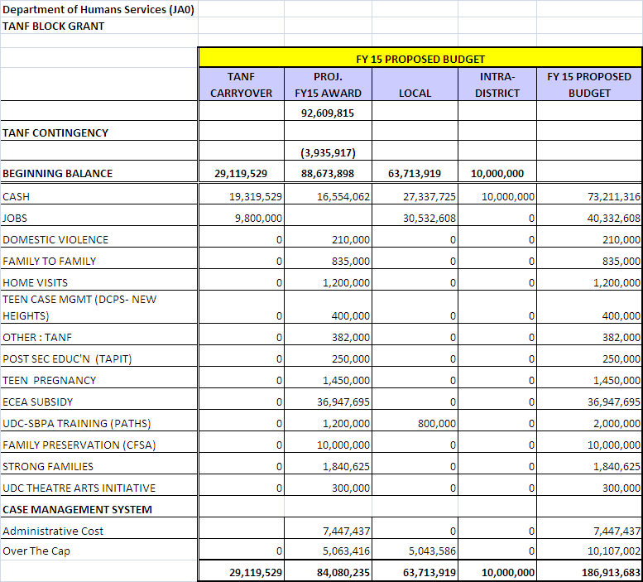
Fy 15 TANF Budget

Slide 10
Interim DISABILITY ASSISTANCE (IDA)
FY 14
Budget $3,040M
Serve 1,000 customers
Currently no waiting list
FY15
Budget $3,540M
Serve 1,350 customers

Slide 11
Questions/Discussion

